Slide 1
Predicting Stock Prices
Isaac Sheets, Abhishek Majumdar and Andrew Cate

Slide 2

Group Collaboration
Weekly team huddle to brainstorm idea
Uniform coding standard, file naming convention followed from day 1 resulted in zero rework.
Individual branches created to put individual codes before merging to main.
Meet with project advisor to review, secure feedback and move forward
Focus on Efficient Coding, Maintainability
Group Review before Merging
Individual Ideas/Code
Brainstorm
N
Consult Project Advisor
Agreement?
Y
Merge to Main branch

Slide 3
Data Preprocessing

Slide 4
Linear Regression

Slide 5
Questions?

Slide 6
Q
Thank you
Questions?

Slide 7
Best Practices
Project issue Tracker
Minutes of Meeting
Project artifacts & Coding name convention document
Frequent open minded collaboration among team members

Slide 8
Title
Keep points clear and simple
Try not to exceed six bullets
Use as little text as possible
Edit your copy to fit the recommended font sizes
Do not use bullet slides as substitute for speaker notes

Slide 9
Two Columns
Keep points clear and simple
Try not to exceed six bullets
Use as little text as possible
Edit your copy to fit the recommended font sizes
Do not use bullet slides as substitute for speaker notes

Slide 10
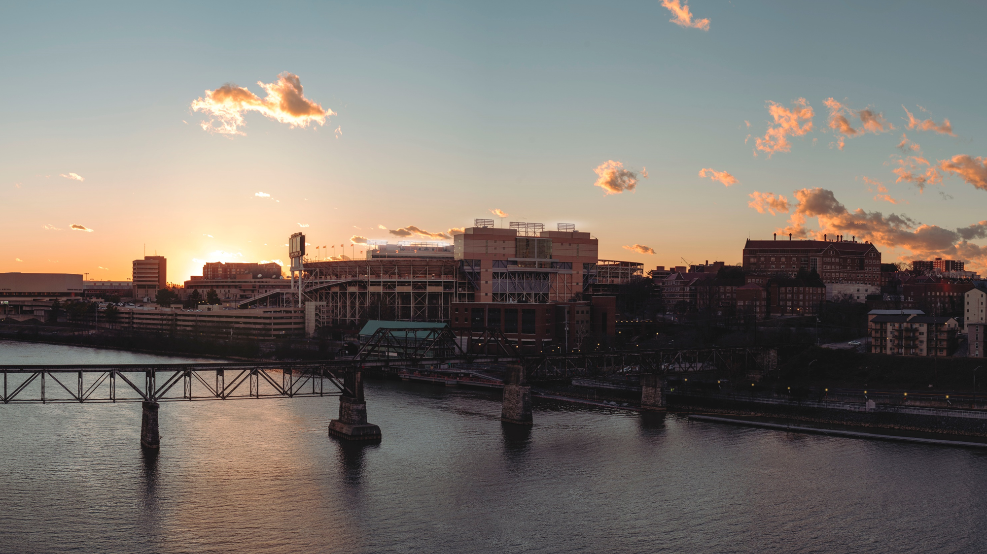
XX%
big stat with shaded image

Slide 11
XX%
big stat

Slide 12
96%
83%
78%
Place text here and use bold to highlight
Place text here and use bold to highlight
Place text here and use bold to highlight

Slide 13
“If there’s a book that you want to read, but it hasn’t been written yet, then you must write it.”
TONI MORRISON

Slide 14
Place text here
LARGE TEXT

Slide 15


Takeaway one with emphasis
And second with callout
Takeaway three description
Section

Slide 16

Our faculty-to-student ratio is 1:17, giving you personal attention and great diversity of ideas.

Slide 17



Cross-Collaboration
Amazing Faculty
Make a Difference
No matter what major you choose, you’ll have many opportunities to work with students and departments across the university.
You’ll learn from award-winning educators, including published authors, Fulbright Scholars, and other amazing professors.
Through experience-learning opportunities, you’ll use your education to make a difference in the world.

Slide 18
Table with Row Highlight
 | Column 1 | Column 2 | Column 3
Row 1 | 0.00 | 0.00 | 0.00
Row 2 | 0.00 | 0.00 | 0.00
Highlight | 0.00 | 0.00 | 0.00
Row 4 | 0.00 | 0.00 | 0.00
Row 5 | 0.00 | 0.00 | 0.00
Row 6 | 0.00 | 0.00 | 0.00
Row 7 | 0.00 | 0.00 | 0.00
Row 8 | 0.00 | 0.00 | 0.00

Slide 19
Table with Column Highlight
Column 1 | Column 2 | Column 3 | Column 4
0.00 | 0.00 | 0.00 | 0.00
0.00 | 0.00 | 0.00 | 0.00
0.00 | 0.00 | 0.00 | 0.00
0.00 | 0.00 | 0.00 | 0.00
0.00 | 0.00 | 0.00 | 0.00
0.00 | 0.00 | 0.00 | 0.00
0.00 | 0.00 | 0.00 | 0.00
0.00 | 0.00 | 0.00 | 0.00

Slide 20
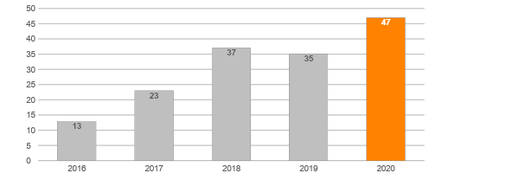
Column Chart with Callout
Callout

Slide 21
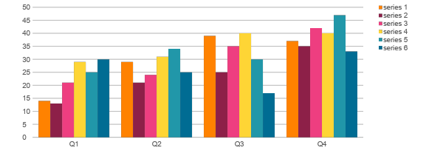
Multicolor Column Chart

Slide 22
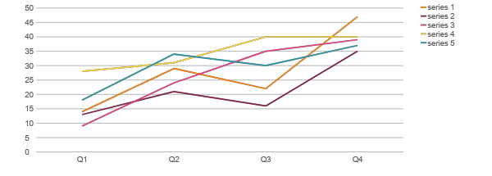
Line Chart

Slide 23
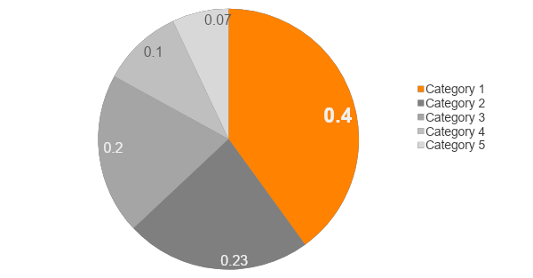
Pie Chart with Highlight

Slide 24
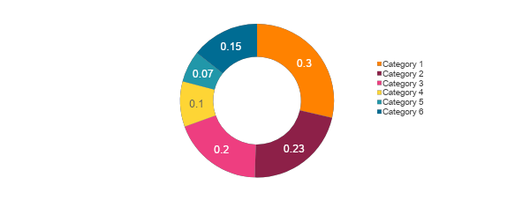
Multicolor Doughnut

Slide 25
SCALABLE LOGOS
For more logo usage information visit:
brand.utk.edu/logos
Centered (Preferred)
Left Aligned
Right Aligned

Slide 26
COLORS
Primary
Tennessee Orange
Hex: FF8200
RGB: 255, 130, 0
Smokey
Hex: 58595B
RGB: 88, 89, 91
White
Hex: FFFFFF
RGB: 255, 255, 255
Accent
When combined with Tennessee Orange, these colors add energy and suggest movement.
Valley
Hex: 00746F
RGB: 0, 116, 111
Torch
Hex: E65933
RGB: 230, 89, 51
Globe
Hex: 006C93
RGB: 0, 108, 147
Limestone
Hex: F0EDE3
RGB: 240, 237, 227
Sunsphere
Hex: FED535
RGB: 254, 213, 53
River
Hex: 517C96
RGB: 81, 124, 150
LeConte
Hex: 8D2048
RGB: 141, 32, 72
Rock
Hex: A7A9AC
RGB: 167, 169, 172
Summitt
Hex: B9E1E2
RGB: 185, 225, 226
Legacy
Hex: 579584
RGB: 87, 149, 132
Buckskin
Hex: 705550
RGB: 112, 85, 80
Switchgrass
Hex: ABC178
RGB: 171, 193, 120
Regalia
Hex: 754A7E
RGB: 117, 74, 126
Fountain
Hex: 2197A9
RGB: 33, 151, 169
Eureka!
Hex: EBEA64
RGB: 235, 234, 100
Energy
Hex: EE3E80
RGB: 238, 62, 128

Slide 27
COLOR SCHEMES
Too many colors can be overwhelming. Best to find a strong combination of three or four colors and use those consistently throughout.
Smokey Limestone
Fountain Torch
Globe LeConte
Energy Eureka!
River Buckskin
Valley Torch
Regalia Limestone
Summitt LeConte
Valley
Limestone
Globe
LeConte
Fountain
Limestone
Legacy
Eureka!
Valley
Valley
Regalia
Summitt
Limestone
LeConte
Buckskin
Switchgrass
Fountain
Smokey
River
Eureka!
Summitt
Energy
Summitt
Sunsphere

Slide 28
TYPOGRAPHY
Gotham is the university’s primary typeface. However this font family is not included in most user’s default systems. For presentation use, Arial Nova is used throughout. (Available with Enterprise or Office 365 installation.) Most type is set in Smokey (not black) with highlights in Bold.
Limit use of italics as it is often difficult to read onscreen. Do not underline text.
Smokey jumped over the alligator.
Arial Nova Regular / Body copy
Smokey jumped over the alligator.
Arial Nova Bold / Headlines
Smokey jumped over the alligator.
Arial Nova Condensed / Captions, Sources

Slide 29
OUR LINGO
One strong, emotional word can tell the UT story using only a few letters. Those words are even more effective when used in concise, direct sentences. Keep the following words and phrases in mind when writing about UT.
ENERGY
VOLUNTEER SPIRIT
DISCOVERY
PRIDE
MOMENTUM
Power
Build
Competitive
Drive
Driven
Enhance
Force
Strengthen
Change
Dynamic
Inspire
Invigorate
Nurture
Transform
Light
Illuminate
Shine
Spark
Torch
Torchbearer
Vibrant
Service
Benefit
Collaborate
Common good
Community
Contribute
Responsibility
Volunteer
Civility
Celebrate
Compassion
Differences
Global citizens
Global community
Humanity
Welcoming
What’s right
Research
Create
Delve
Dig
Explore
Hunt
Imagine
Invent
Investigate
Results
Discovery
Opportunity
Possibility
Potential
Solutions
History
“Beacon shining bright”
Big Orange
Spirit
The Hill
Torch
Torchbearer
Tradition
Volunteer
Leadership
Big Orange
Competitive
Confidence
Spirit
Welcome
Future
Aspiration
Hope
Opportunity
Optimism
Possibility
Promise

Slide 30
STYLE ELEMENTS
Lines
Arrows
SMOKEY LINE
SMOKEY LINE
TENNESSEE ORANGE LINE
TENNESSEE ORANGE LINE
ROCK LINE
ROCK LINE
DOTTED SMOKEY LINE
DOTTED SMOKEY LINE
DOTTED TENNESSEE ORANGE LINE
DOTTED TENNESSEE ORANGE LINE
DOTTED ROCK LINE
DOTTED ROCK LINE
LARGE SMOKEY ARROW
LARGE TENNESSEE ORANGE ARROW
LARGE ROCK ARROW

Slide 31
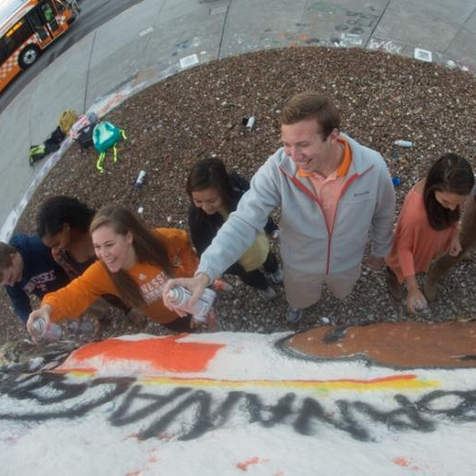
CALLOUTS, LABELS, ELEMENTS
Rectangles
One
BIG
Thing
RECTANGLE WITH OUTLINE
LIGHT GRAY TRANSPARENT OVERLAY
Labels
Call Outs
Important
STAT
We love
THE ROCK
LABEL
SMALL CIRCLES
LABEL
LABEL
FILLED CIRCLES

Slide 32
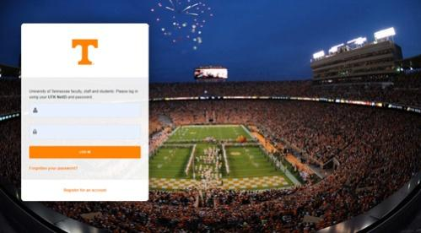
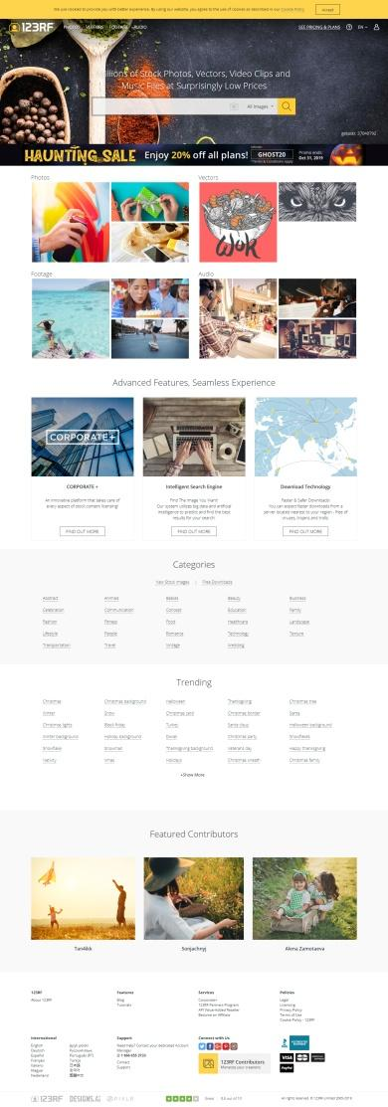
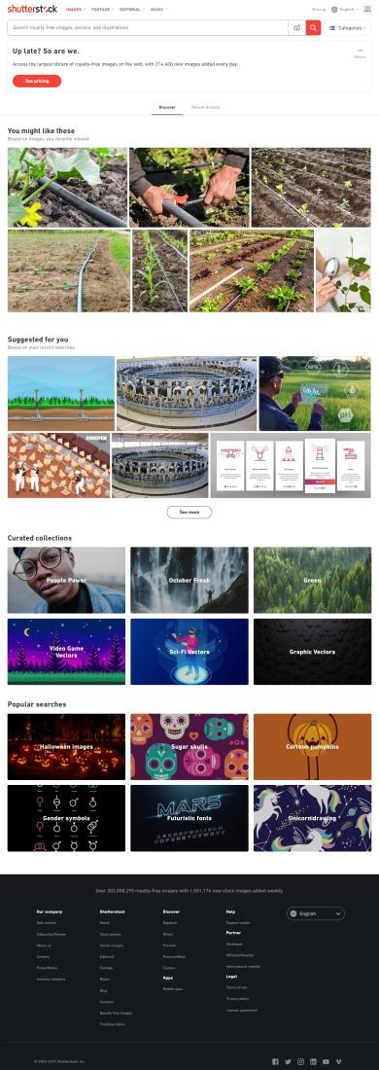
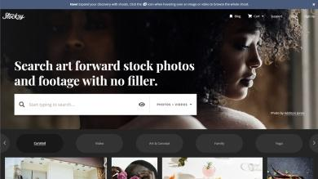
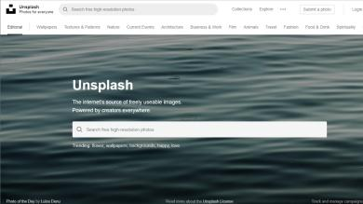
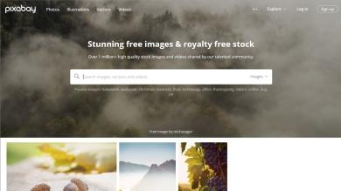
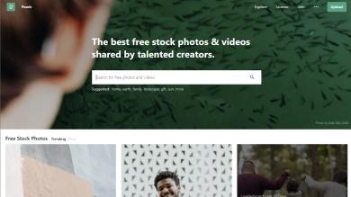
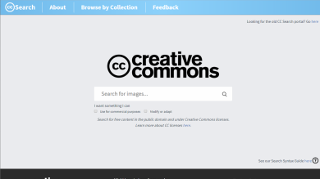
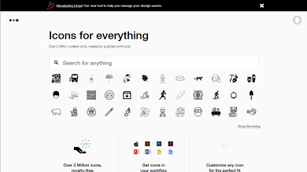
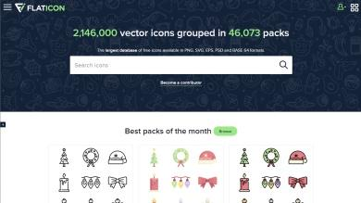
IMAGES + ICONS
UT Image Bank
assetbank.ath.utk.edu
123RF ($)
123rf.com
Shutterstock ($$$)
shutterstock.com
Stocky ($$$)
stocksy.com
Unsplash (Free)
unsplash.com
Pixabay (Free)
pixabay.com
Pexels (Free)
pexels.com
Creative Commons (Free)
search.creativecommons.org
The Noun Project (free/$)
thenounproject.com
Flat Icon (Free)
flaticon.com

